Slide 1
Medication recommendation
By Ibra Cisse
Jason Jensen

Slide 2
Introduction
A database project to collection information about the most common medicine.
Ranking each medicine based on their daily use and how effective they are.
Reviews are based on customers ranking
Ranking can change based on Admin standards, clients, or customer writing reviews

Slide 3
Database And Architecture
For the DML, we decided to use MYSQL along with java as front end.
This project has 7 entities that interact through link and queries.
The 7 entities are:
Users:
Admin: have the most privilege to change anything on the database
Clients: can write, read, and update ranking of medicine based on their use.

Slide 4
Database And Architecture(Cont’)
Information:
Symptoms: users can search based on symptoms that they have.
Medicine: holds generic and brand names for mostly used medicine.
Ingredients: list of ingredient for the medicine for users to see.
Sales Value: Generic name, pricing for the city and also average prices
Reviews: holds reviews and suggestion from customers and clients as well

Slide 5
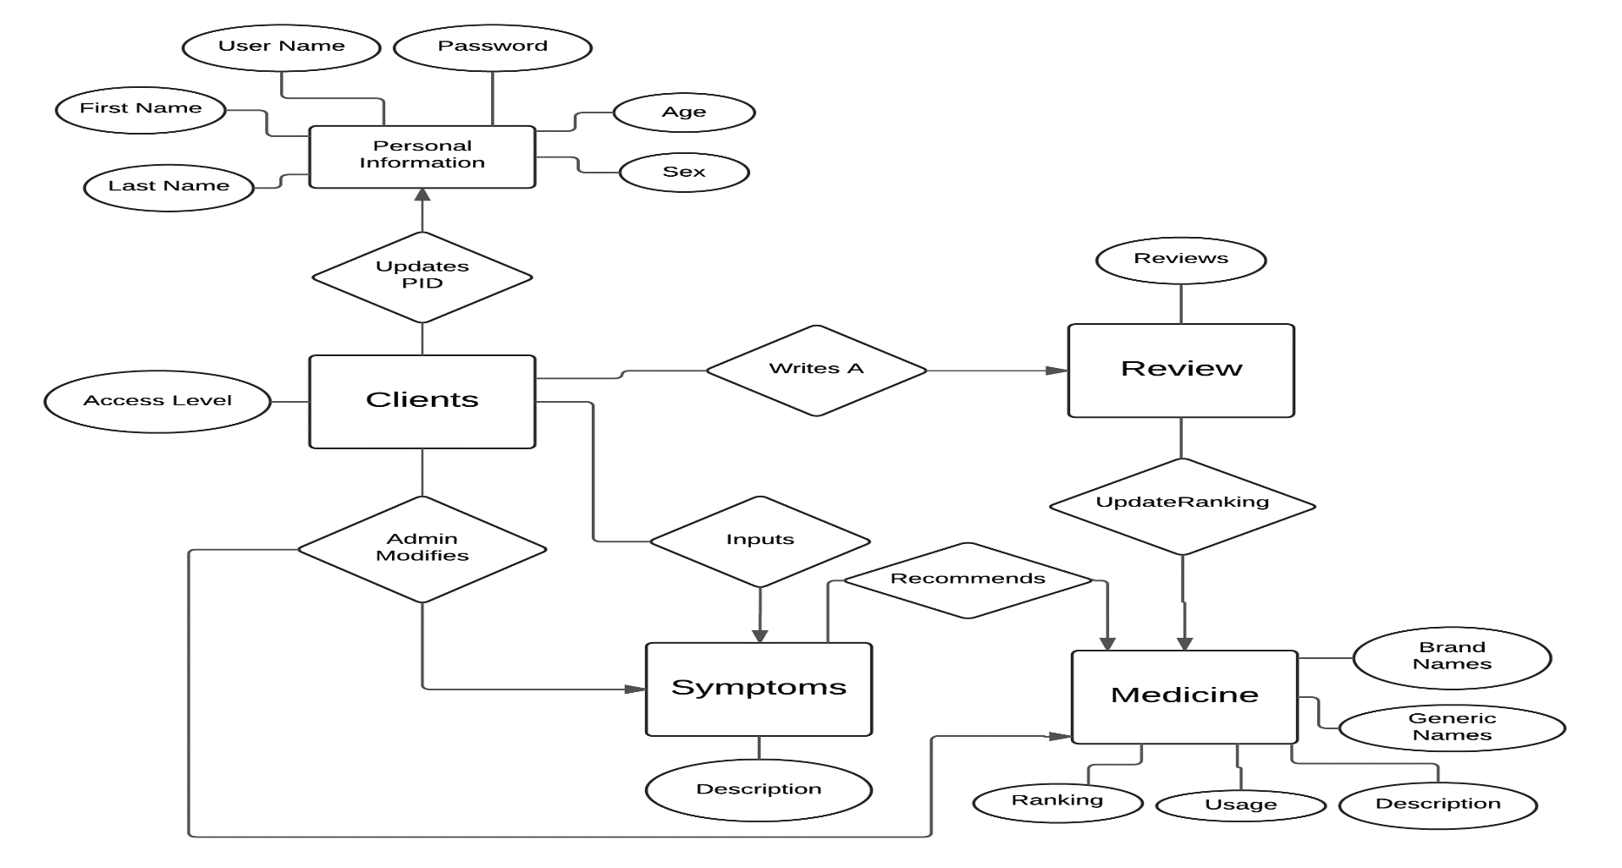
Diagram

Slide 6
Use Case and Results
Administrator login
Client Log in
Client sign up
Administrator creates a table
User asks the highest rated medicine along with its generic name
Client writes a review

Slide 7
Use Case and Results(Cont’)
Client asked for average price on a city
Client asked for the highest medicine along with its price and ranking from a specific city
Client asks for average medication for a symptom on a specific city descending order

Slide 8
Now Presenting use cases
Pay attention to the codes ☺

Slide 9
End
The End.
Any questions, comments, or suggestion.

Slide 10
Credits and project source code
Ibra Cisse
http://github.com/Amatarasu/DB
Jason Jensen:
http://github.com/jensenj5/DB

